Slide 1
Image Features
Course 3, Module 2, Lesson 1

Slide 2
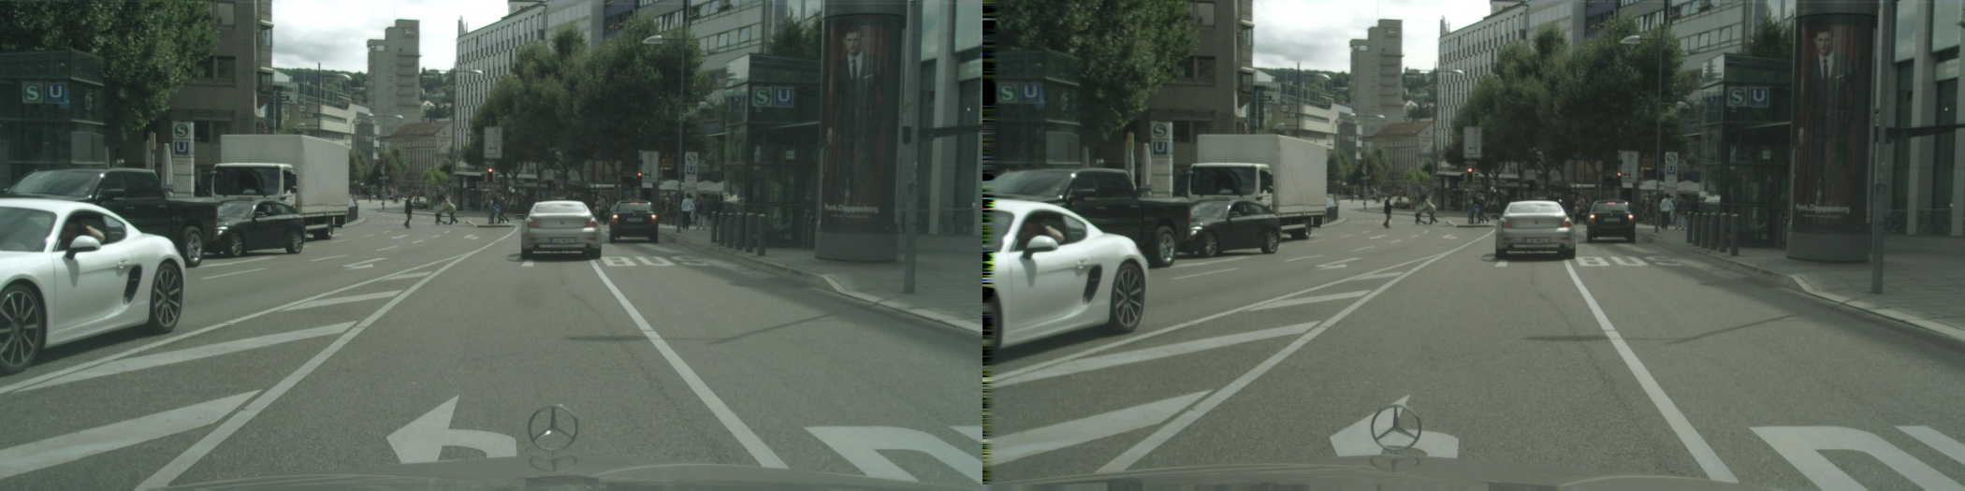
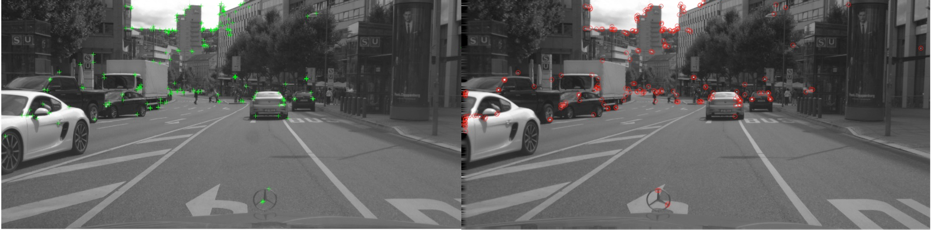
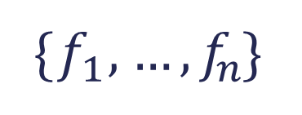
Image Features: A General Process
Image stitching: the process of combining multiple photographic images with overlapping fields of view to produce a segmented panorama(パノラマ、全景) or high-resolution image.
Detection and description
Images from CITYSCAPES dataset: https://www.cityscapes-dataset.com/
{$f_{1}$, … , $f_{n}$}
associate a descriptor for each feature from its neighborhood.

Slide 3
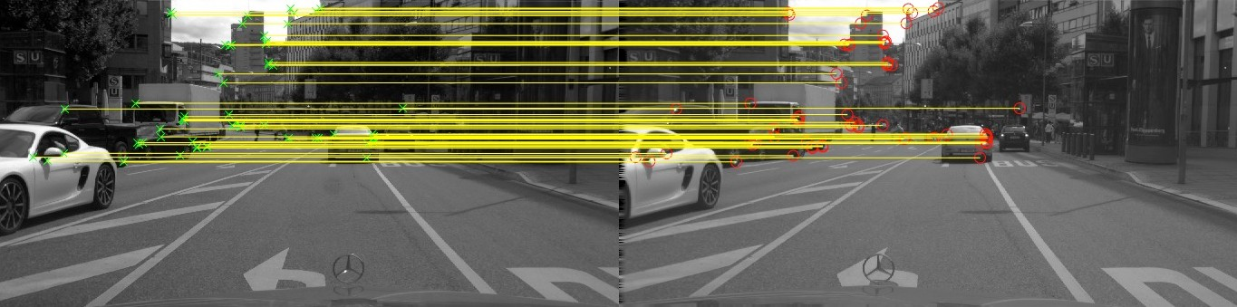
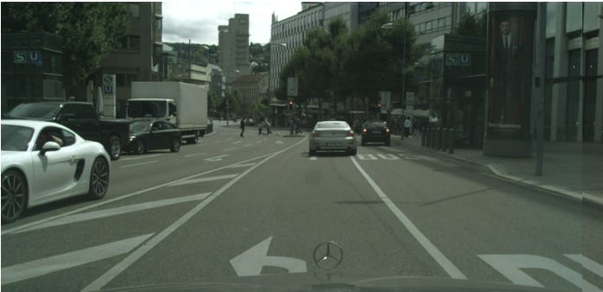
Image Features: A General Process
Images from CITYSCAPES dataset: https://www.cityscapes-dataset.com/
matching

Slide 4
Feature Detection
Features are points of interest in an image
Points of interest should have the following characteristics:
Saliency（はっきり目立つ、顕著「けんちょ」）: distinctive, identifiable, and different from its immediate neighborhood
Repeatability（再現性）: can be found in multiple images using same operations
Locality: occupies a relatively small subset of image space
Quantity: enough points represented In the image
Efficiency: reasonable computation time
The features should not change if an image region far away from the immediate neighborhood changes.
This is because many applications such as calibration and localization require a minimum number of distinctive points to perform effectively.

Slide 5
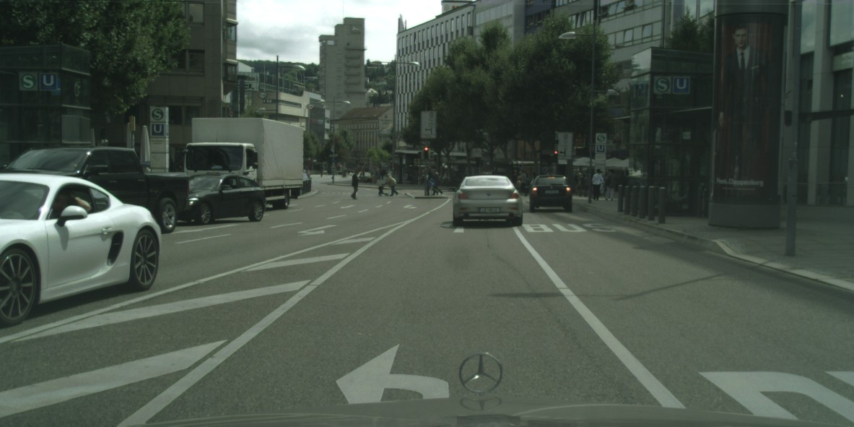
Feature Extraction
Repetitive texture less patches are challenging to detect consistently
Patches with large contrast（コントラスト） changes (gradients) are easier to detect (edges)
Gradients in at least two (significantly) different orientations are the easiest to detect (corners)
A corner occurs when the gradients in at least two significantly different directions are large.
The most famous corner detector is the Harris Corner Detector, which uses image gradient information to identify pixels that have a strong change in intensity in both x and y directions.

Slide 6
Feature Detection: Algorithms
Meaning that the corners can look different depending on the distance the camera is away from the object generating the corner.
Harris {corners}: Easy to compute, but not scale invariant. [Harris and Stephens, 1988]
Harris-Laplace {corners}: Same procedure as Harris detector, addition of scale selection based on Laplacian. Scale invariance. [Mikolajczyk, 2001]
Features from accelerated segment test (FAST) {corners}: Machine learning approach for fast corner detection. [Rosten and Drummond, 2006]
Laplacian of Gaussian (LOG) detector {blobs}: Uses the concept of scale space in a large neighborhood (blob). Somewhat scale invariant. [Lindeberg,1998]
Difference of Gaussian (DOG) detector {blobs}: Approximates LOG but is faster to compute. [Lowe, 2004]
second-degree intensity derivatives（2次微分）
SIFTに使われる
https://docs.opencv.org/master/d0/d13/classcv_1_1Feature2D.html

Slide 7
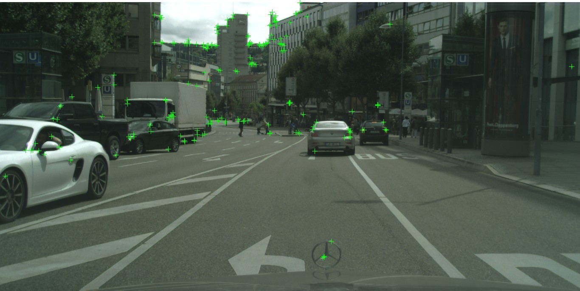
Feature Extraction: Harris Corners

Slide 8
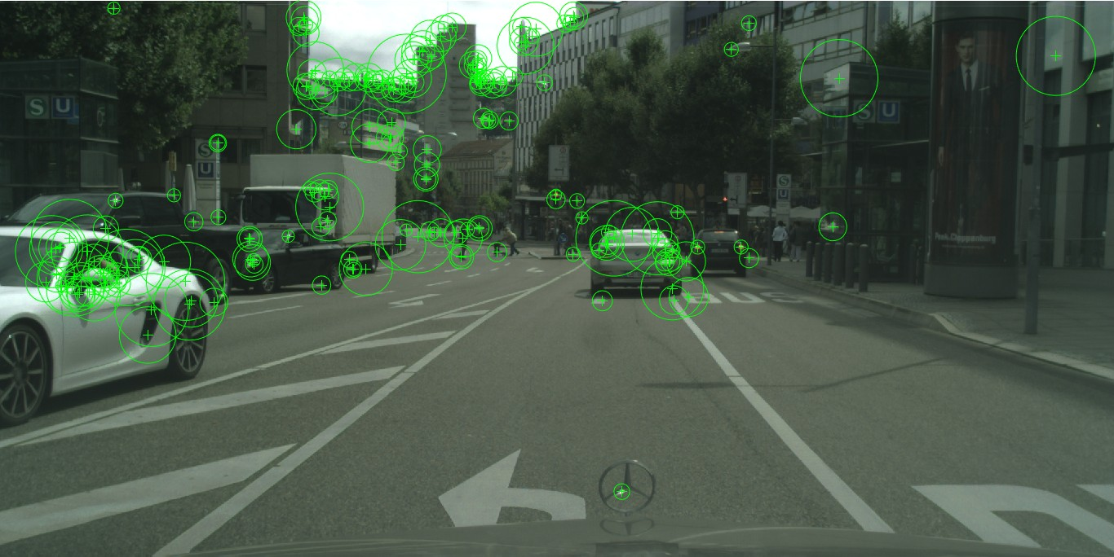
Feature Extraction: Harris Laplace
By using the Laplacian to determine scale, we can detect scale invariant corners that can be more easily matched as a vehicle moves relative to the scene.
Scale is represented here by the size of the circle around each feature.
The larger the circle, the larger the principal scale of that feature.

Slide 9
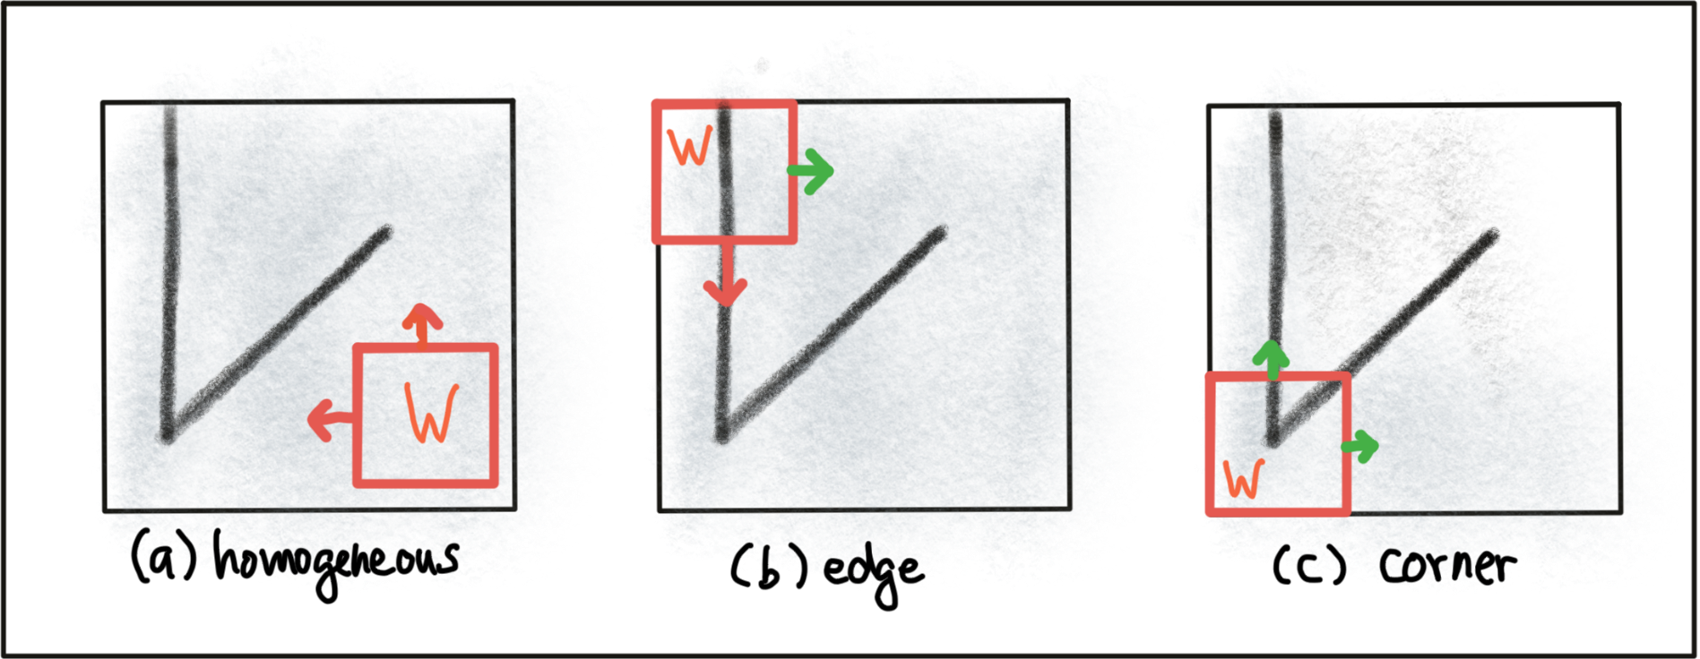
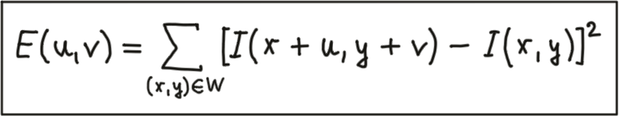
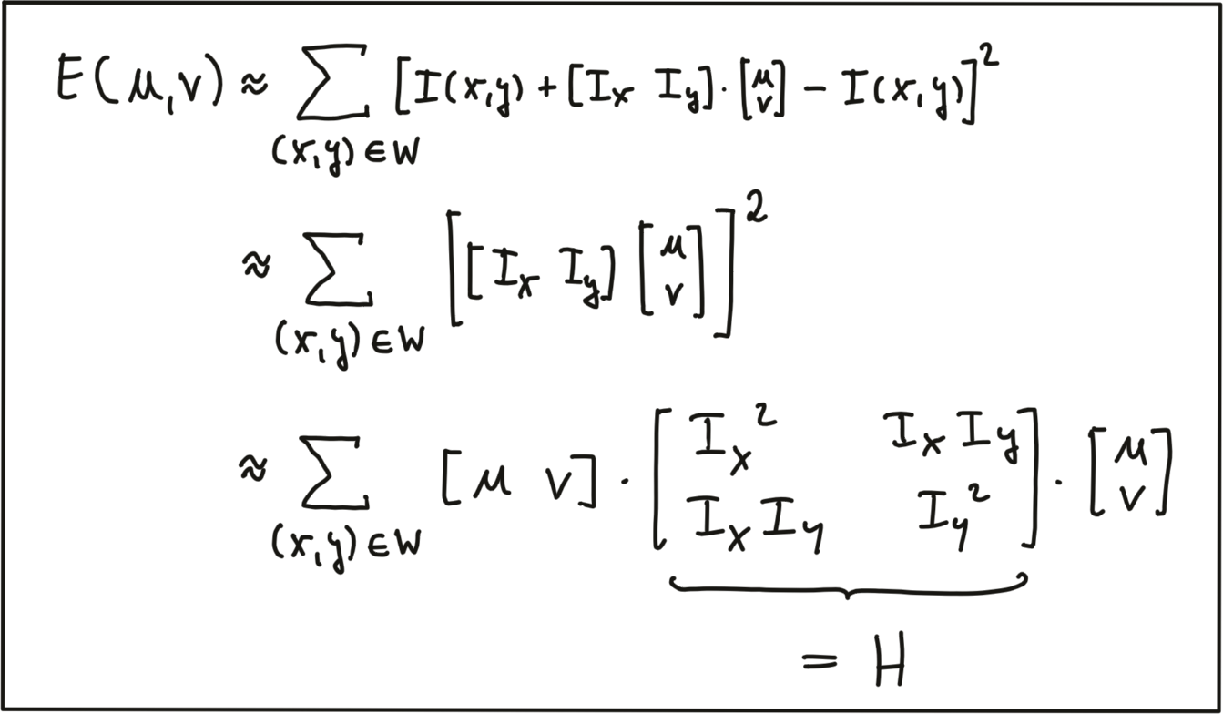
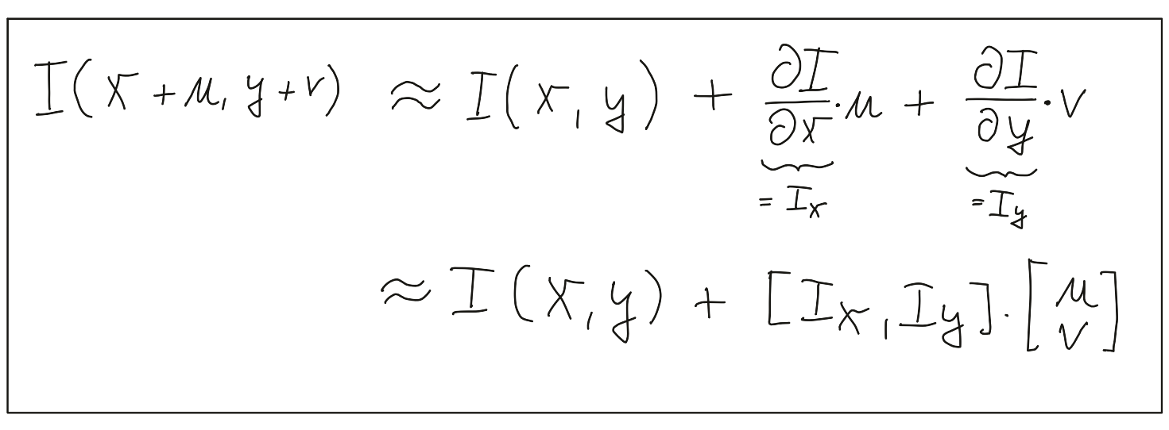
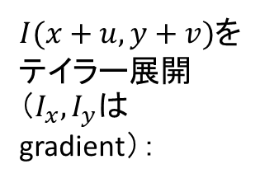
Harris Corner Detection: Local Measures of Uniqueness (from Udacity)
In order to locate a corner, we consider how the content of the window(オレンジ色の枠だろう) would change when shifting it by a small amount.
(a): there is no measurable change in any coordinate direction at the current location of the red Window W.
(b): there will be significant change into the direction orthogonal to the edge and no change when moving into the direction of the edge.
(c): the window content will change in any coordinate direction.
$I(x+u,y+v)$をテイラー展開（$I_{x},I_{y}$はgradient）：

Slide 10
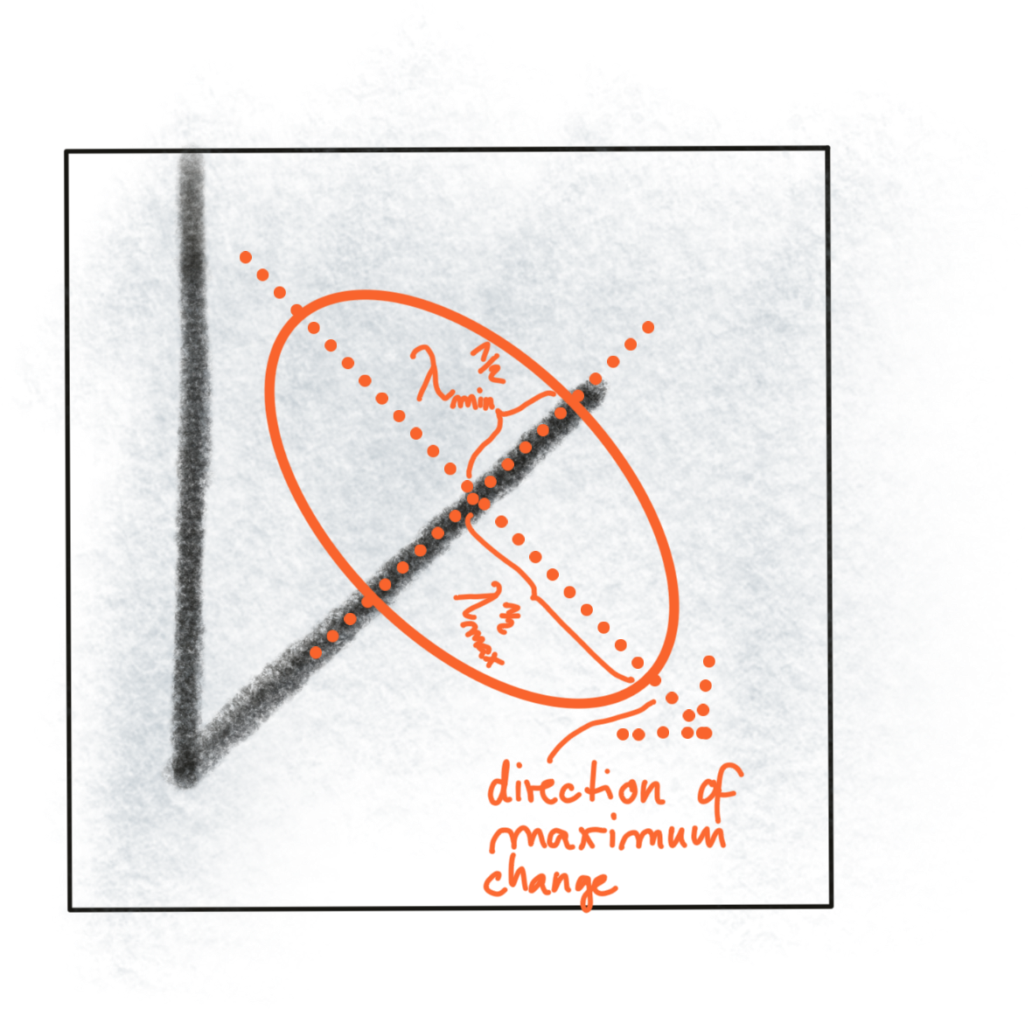
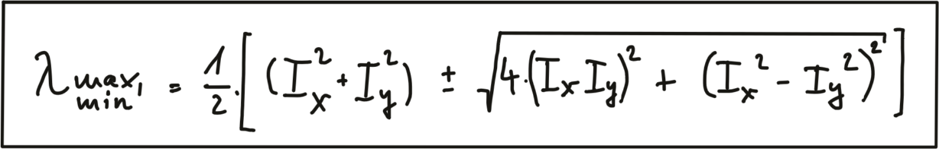
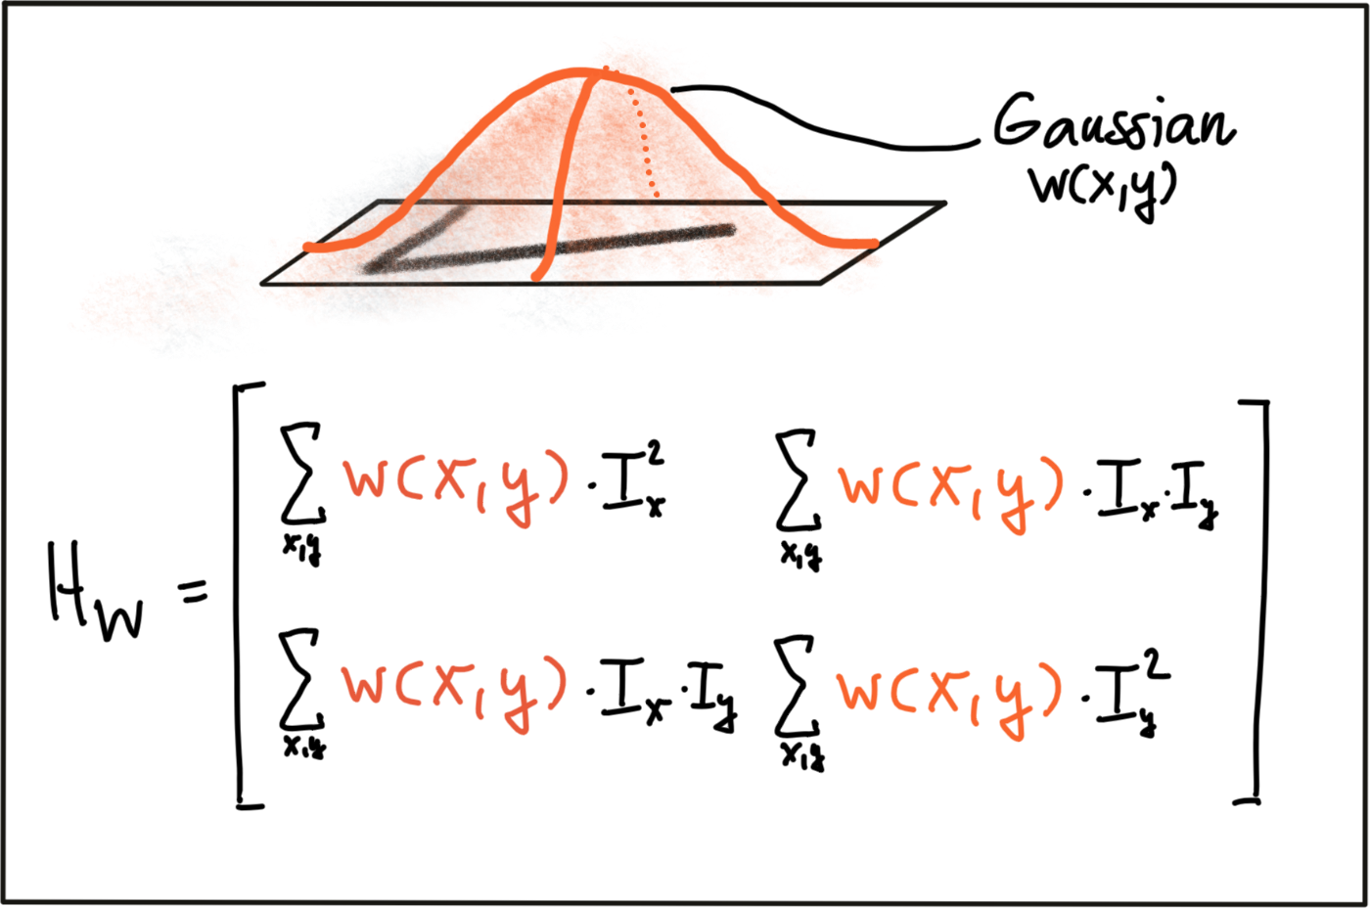
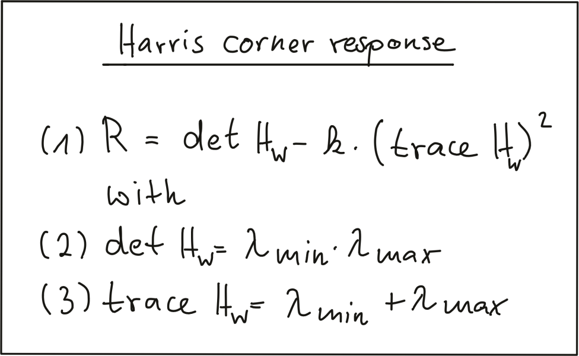
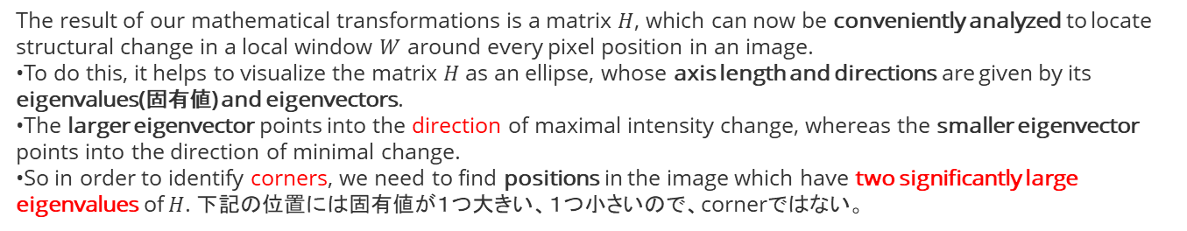
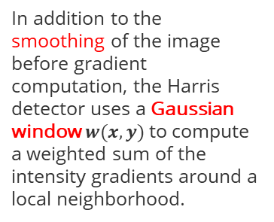
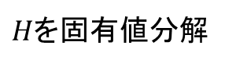
Harris Corner Detection: Local Measures of Uniqueness
1
$H$を固有値分解
The result of our mathematical transformations is a matrix $H$, which can now be conveniently analyzed to locate structural change in a local window $W$ around every pixel position in an image.
To do this, it helps to visualize the matrix $H$ as an ellipse, whose axis length and directions are given by its eigenvalues(固有値) and eigenvectors.
The larger eigenvector points into the direction of maximal intensity change, whereas the smaller eigenvector points into the direction of minimal change.
So in order to identify corners, we need to find positions in the image which have two significantly large eigenvalues of $H$​. 下記の位置には固有値が１つ大きい、１つ小さいので、cornerではない。
固有値の計算式
2
In addition to the smoothing of the image before gradient computation, the Harris detector uses a Gaussian window ​$w(x,y)$ to compute a weighted sum of the intensity gradients around a local neighborhood.
Gaussian windowはscaleの選択ともつながる
3
最終のresponse式、固有値のみ使っている

Slide 11
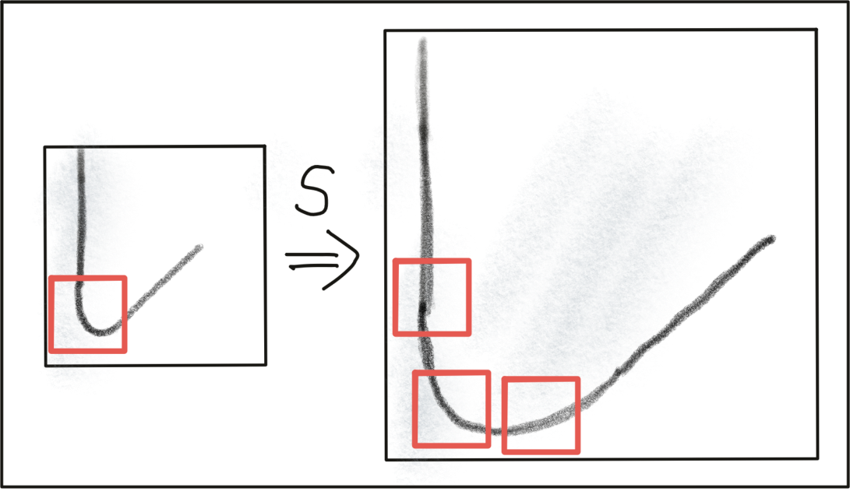
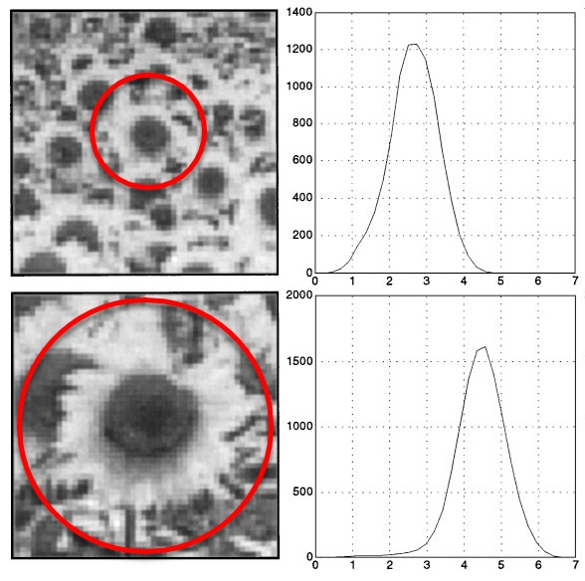
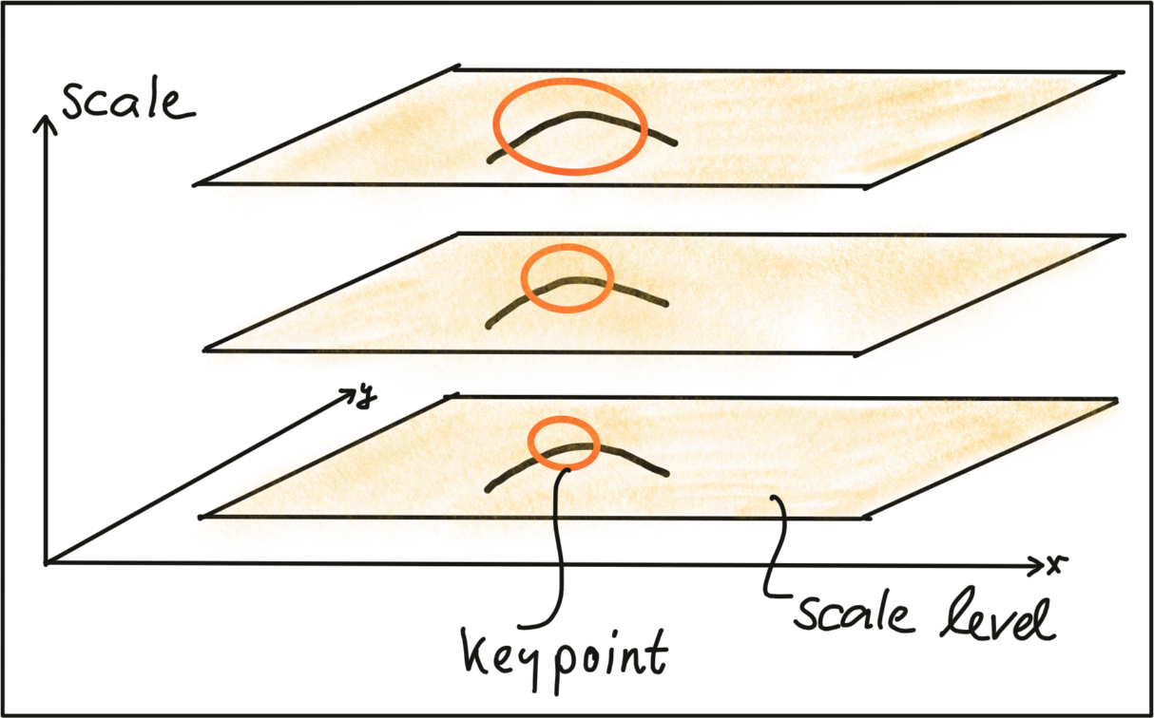
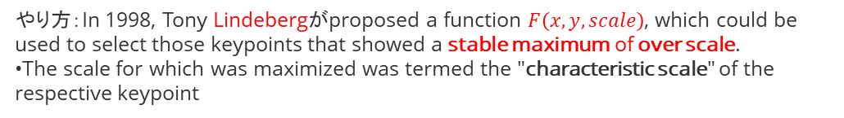
Automatic Scale Selection
やり方：In 1998, Tony Lindebergがproposed a function $F\left(x,y,scale\right)$, which could be used to select those keypoints that showed a stable maximum of over scale.
The scale for which was maximized was termed the "characteristic scale" of the respective keypoint
Harris Cornerの課題：scaleに無力（固定サイズwindow）
If the keypoint scale is unknown or if keypoints with varying size exist in the image, detection must be performed successively at multiple scale levels.
A good detector is able to automatically select the characteristic scale of a keypoint based on structural properties of its local neighborhood.
Modern keypoint detectors usually possess this ability and are thus robust under changes of the image scale.

Slide 12
Image Feature Descriptors
Course 3, Module 2, Lesson 2

Slide 13
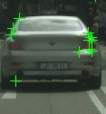
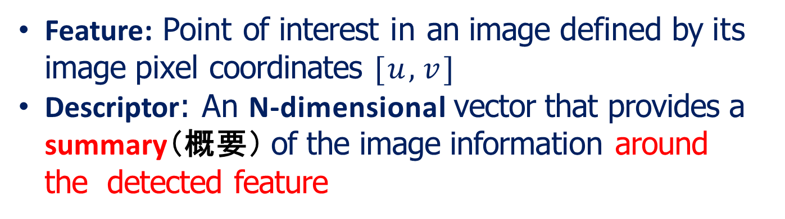
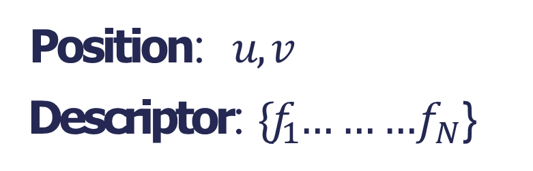
Feature Descriptors
Feature: Point of interest in an image defined by its image pixel coordinates [$u,v$]
Descriptor: An N-dimensional vector that provides a summary（概要） of the image information around the detected feature
Position: $u,v$
Descriptor: {$f_{1}$… … …$f_{N}$}

Slide 14
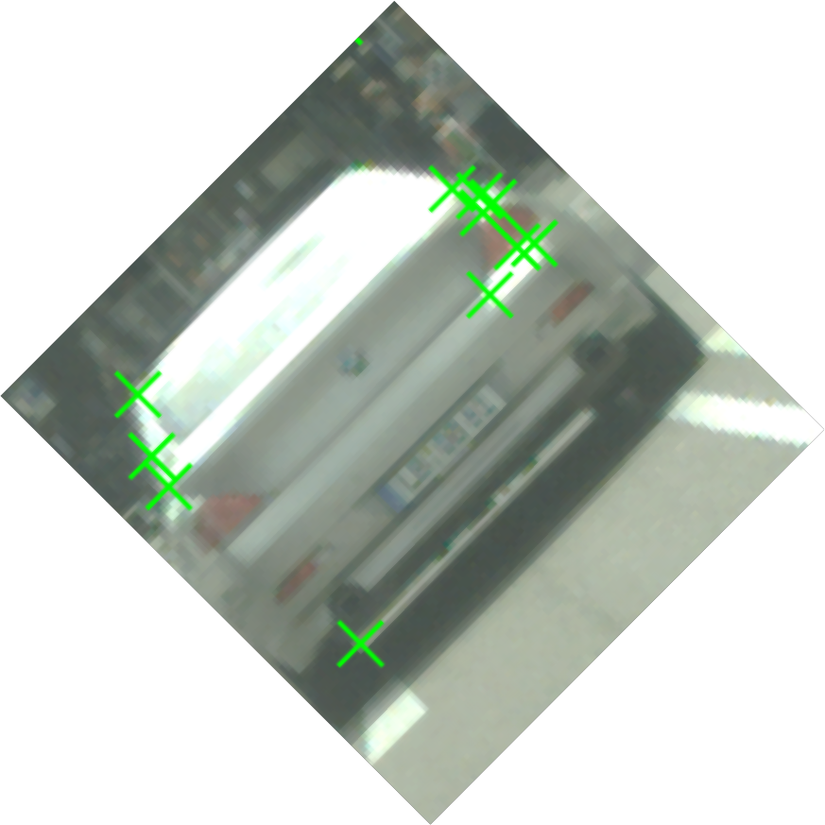
Feature Descriptors
Feature descriptors should have the following characteristics:
o Repeatability: manifested as robustness and invariance to translation, rotation, scale, and illumination changes
不変性でしょう
=

Slide 15
Feature Descriptors
Feature descriptors should have the following characteristics:
Repeatability: manifested as robustness and invariance to translation, rotation, scale, and illumination changes
Distinctiveness（弁別性）: should allow us to distinguish between two close by features, very important for matching later on
≠

Slide 16
Feature Descriptors
Feature descriptors should have the following characteristics:
Repeatability: manifested as robustness and invariance to translation, rotation, scale, and illumination changes
Distinctiveness: should allow us to distinguish between two close by features, very important for matching later on
Compactness & Efficiency: reasonable computation time
Compactness（緊密さ）はdescriptorのサイズを言っていると思う。

Slide 17
たくさんのDescriptors
Scale Invariant Feature Transform（SIFT）
Speeded-Up Robust Features (SURF)
Gradient Location-Orientation Histogram (GLOH)
Binary Robust Independent Elementary Features (BRIEF)
Oriented Fast and Rotated Brief (ORB)
Many more !
use similar concepts to SIFT while being significantly faster to compute.
Gradient-based（HoG, Histogram of Gradients） Descriptors （上3つ）
Binary Descriptors（下２つ）
Some like SIFT and SURF are patented（特許「とっきょ」） and should not be used commercially without approval of the authors.
しかし、some really good algorithms such as ORB match the performance of SIFT and SURF and are free to use even commercially.

Slide 18
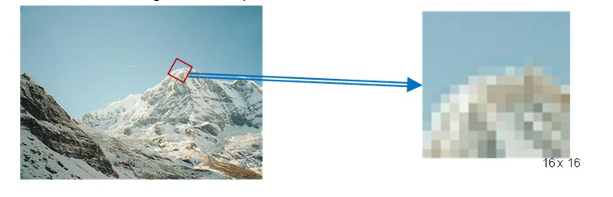
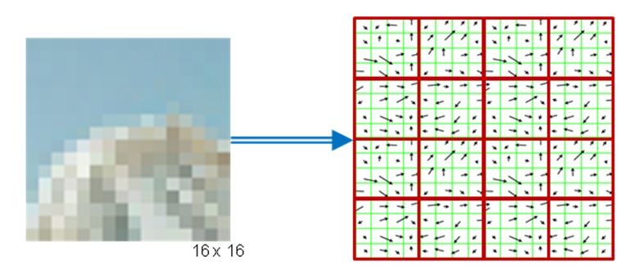
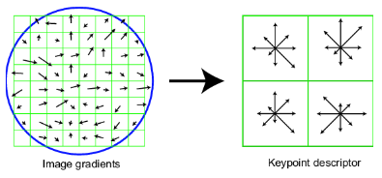
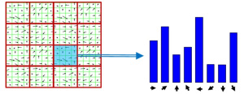
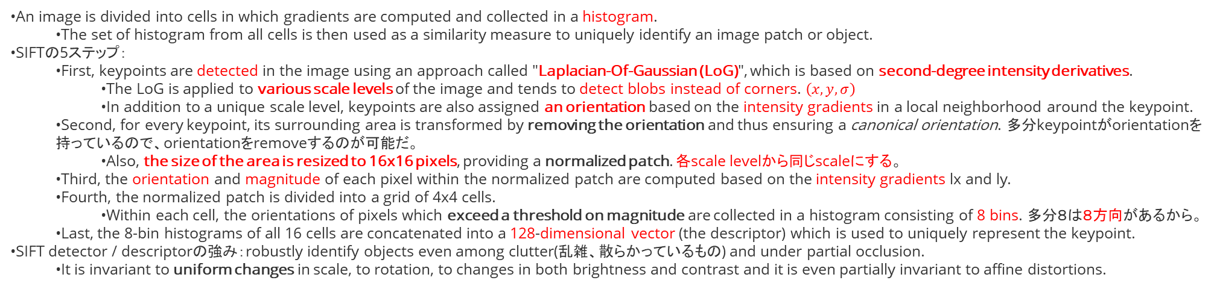
HOG Descriptors and SIFT (from Udacity)
3. Orientation Assignmentにan orientation histogram with 36 bins covering 360 degreesが書いてある：https://docs.opencv.org/master/da/df5/tutorial_py_sift_intro.html
An image is divided into cells in which gradients are computed and collected in a histogram.
The set of histogram from all cells is then used as a similarity measure to uniquely identify an image patch or object.
SIFTの5ステップ：
First, keypoints are detected in the image using an approach called "Laplacian-Of-Gaussian (LoG)", which is based on second-degree intensity derivatives.
The LoG is applied to various scale levels of the image and tends to detect blobs instead of corners. $\left(x,y,σ\right)$
In addition to a unique scale level, keypoints are also assigned an orientation based on the intensity gradients in a local neighborhood around the keypoint.
Second, for every keypoint, its surrounding area is transformed by removing the orientation and thus ensuring a canonical orientation. 多分keypointがorientationを持っているので、orientationをremoveするのが可能だ。
Also, the size of the area is resized to 16x16 pixels, providing a normalized patch. 各scale levelから同じscaleにする。
Third, the orientation and magnitude of each pixel within the normalized patch are computed based on the intensity gradients lx and ly.
Fourth, the normalized patch is divided into a grid of 4x4 cells.
Within each cell, the orientations of pixels which exceed a threshold on magnitude are collected in a histogram consisting of 8 bins. 多分８は８方向があるから。
Last, the 8-bin histograms of all 16 cells are concatenated into a 128-dimensional vector (the descriptor) which is used to uniquely represent the keypoint.
SIFT detector / descriptorの強み：robustly identify objects even among clutter(乱雑、散らかっているもの) and under partial occlusion.
It is invariant to uniform changes in scale, to rotation, to changes in both brightness and contrast and it is even partially invariant to affine distortions.
16 x 16 pixels. Normalized patch. Blobたちが同じscaleになる。
Histogram of Gradients (HOG)
https://www.uio.no/studier/emner/matnat/its/TEK5030/v19/lect/lecture_4_1_feature_descriptors.pdf
4 x 4 cells.
Each cell 8-bin histogramで表示.（8 * 4 x 4 = 128D vector）

Slide 19
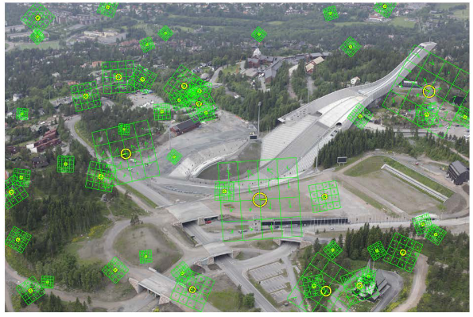
Scale Invariant Feature Transform
SIFT is an example of a very well human engineered feature descriptor, and is used in many state-of-the-art systems
The above process is usually compute on rotated and scaled version of the 16 x 16 window, allowing for better scale robustness
Combined with the DOG feature detector, SIFT descriptors provide a scale, rotation, and illumination invariant detector/descriptor pair
DoGはまだ理解できていない
https://www.uio.no/studier/emner/matnat/its/TEK5030/v19/lect/lecture_4_1_feature_descriptors.pdf

Slide 20
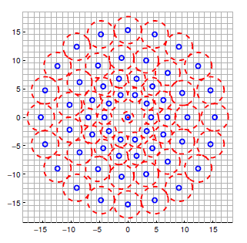
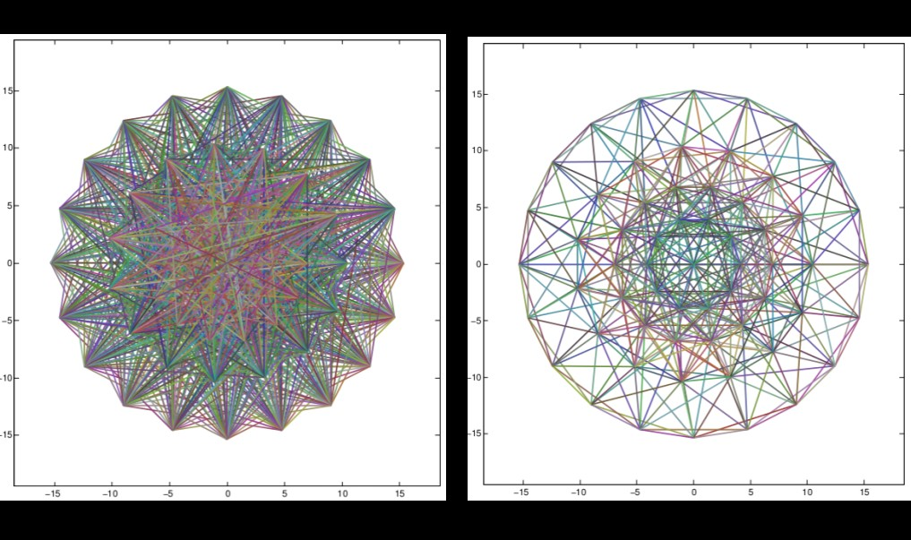
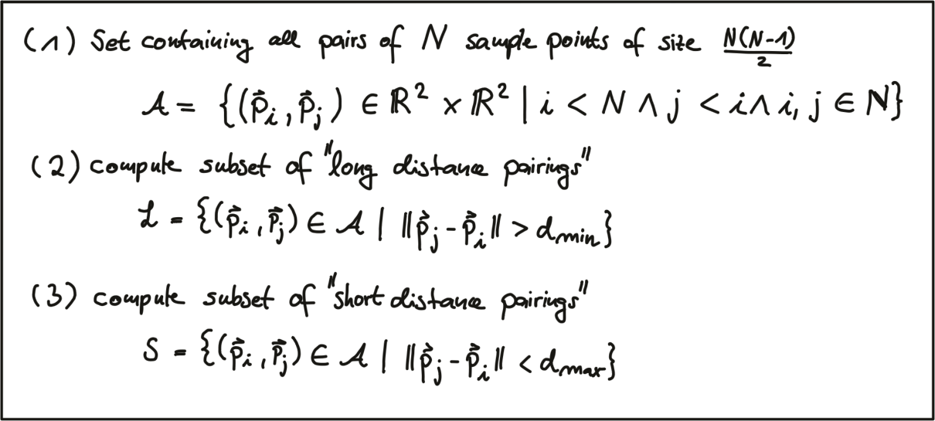
Binary Descriptors and BRISK (from Udacity)
The central idea of binary descriptors is to rely solely on the intensity information (i.e. the image itself) and to encode the information around a keypoint in a string of binary numbers, which can be compared very efficiently in the matching step, when corresponding keypoints are searched.
Binary descriptorの３parts:
A sampling pattern which describes where sample points are located around the location of a keypoint. 多分keypoint位置との相対位置。
A method for orientation compensation, which removes the influence of rotation of the image patch around a keypoint location.
A method for sample-pair selection, which generates pairs of sample points which are compared against each other with regard to their intensity values.
If the first value is larger than the second, '1' into the binary string, otherwise '0'.
After performing this for all point-pairs in the sampling pattern, a long binary chain (or, string) is created.
①The sampling pattern of BRISK is composed out of a number of sample points (blue), where a concentric ring (red) around each sample point denotes an area where Gaussian smoothing is applied.
As opposed to some other binary descriptors such as ORB or BRIEF, the BRISK sampling pattern is fixed.
The smoothing is important to avoid aliasing (an effect that causes different signals to become indistinguishable when sampled).
Gradient計算なし
②During sample pair selection, the BRISK algorithm differentiates between long- and short-distance pairs.
The long-distance pairs are used for estimating the orientation of the image patch from intensity gradients, whereas the short-distance pairs are used for the intensity comparisons from which the descriptor string is assembled. long-distance pairsはorientationを担当する、short-distance pairsはdescriptorを担当。
short pairs (left) and long pairs (right)
長距離ペアsetや短距離ペアset

Slide 21
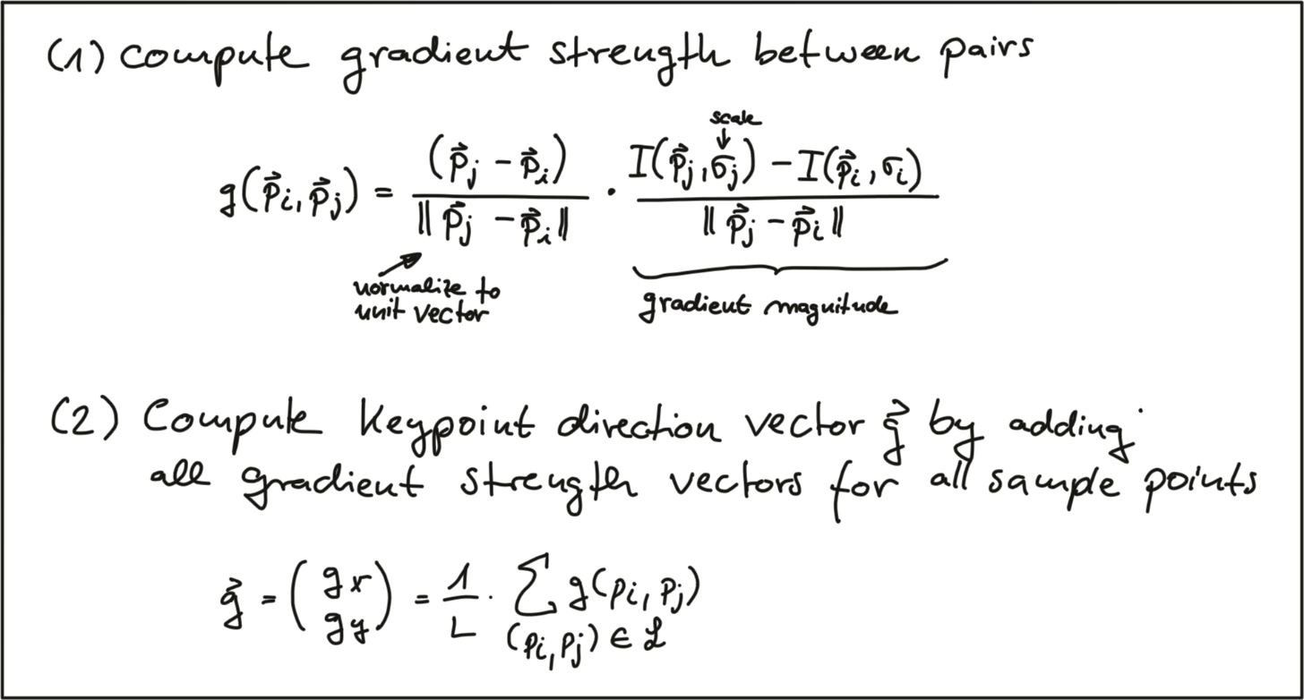
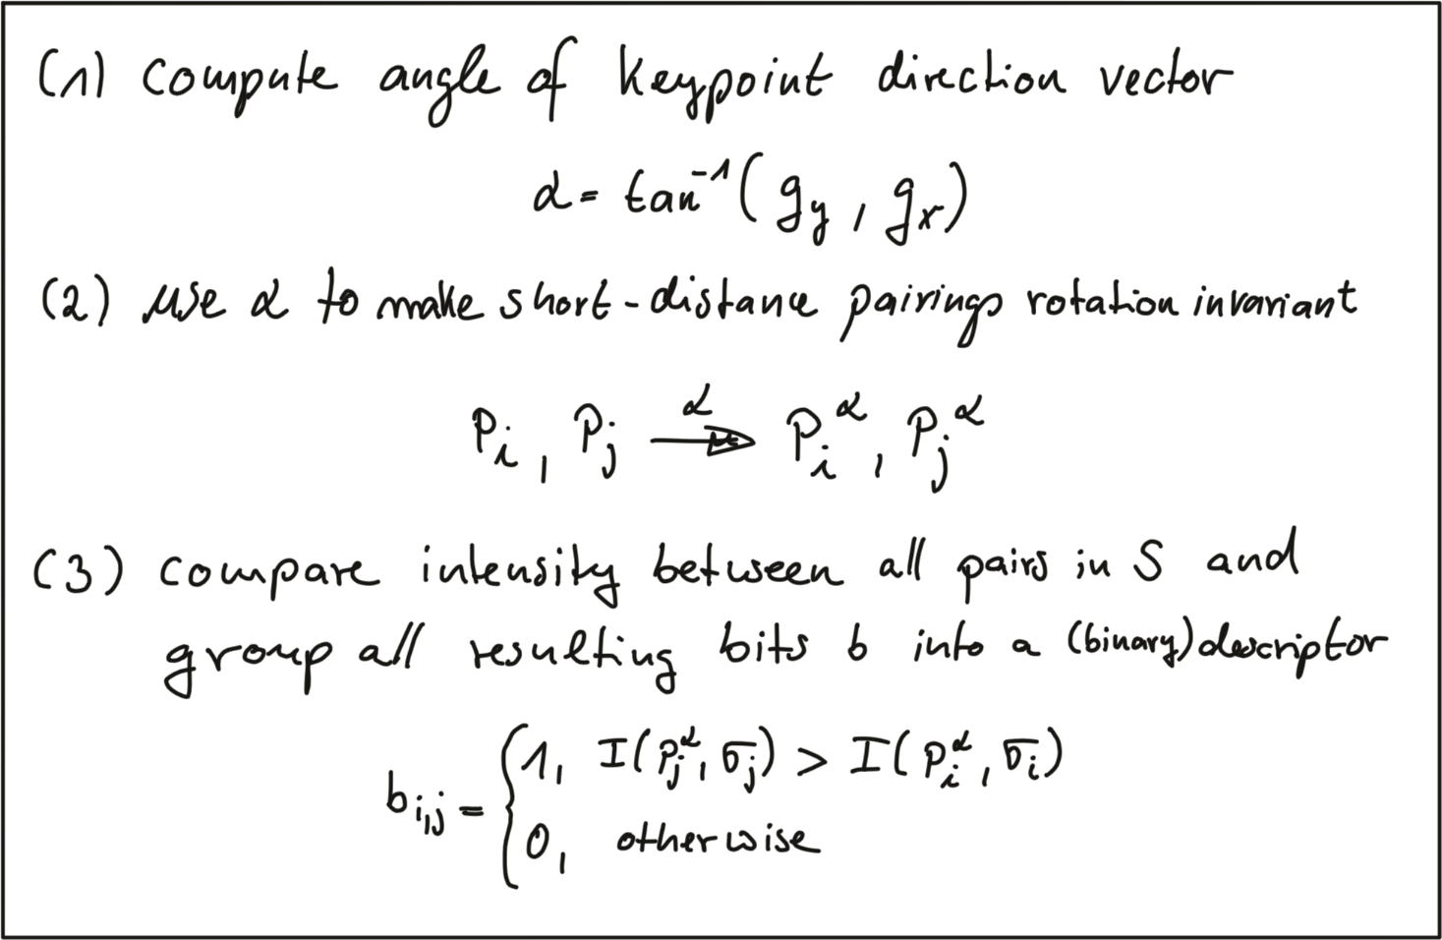
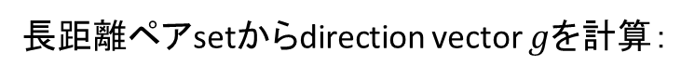
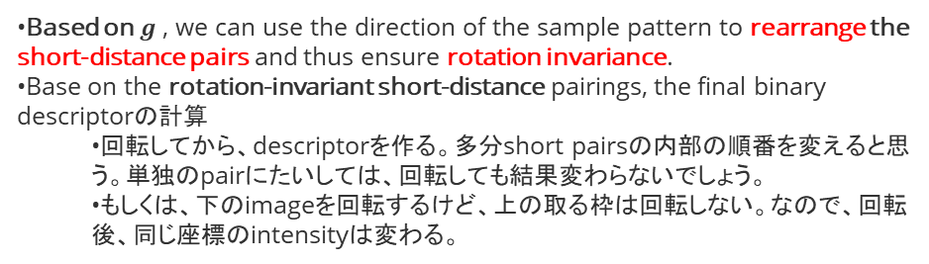
Binary Descriptors and BRISK続き
長距離ペアsetからdirection vector $g$を計算：
1
https://gilscvblog.com/category/descriptors/
上記のブログにBRIEF, ORB, BRISK, FREAKなどのbinary descriptors紹介した。
2
Based on $g$ , we can use the direction of the sample pattern to rearrange the short-distance pairs and thus ensure rotation invariance.
Base on the rotation-invariant short-distance pairings, the final binary descriptorの計算
回転してから、descriptorを作る。多分short pairsの内部の順番を変えると思う。単独のpairにたいしては、回転しても結果変わらないでしょう。
もしくは、下のimageを回転するけど、上の取る枠は回転しない。なので、回転後、同じ座標のintensityは変わる。
Scaleをどう対応しているかはまだ分かっていない

Slide 22
Feature Matching
Course 3, Module 2, Lesson 3 – Part 1

Slide 23
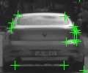
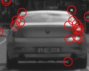
Feature Matching
Feature Matching: Given a feature and its descriptor
in image 1, find the best match in image 2
?
Image 1
Image 2

Slide 24
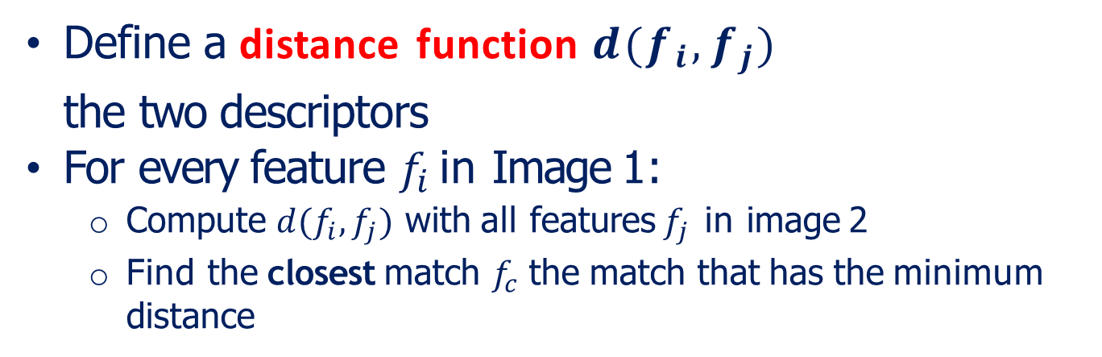
Brute Force Feature Matching
Define a distance function $d(f_{i},f_{j})$
the two descriptors
For every feature $f_{i}$ in Image 1:
Compute $d(f_{i},f_{j})$ with all features $f_{j}$ in image 2
Find the closest match $f_{c}$ the match that has the minimum distance
that compares

Slide 25
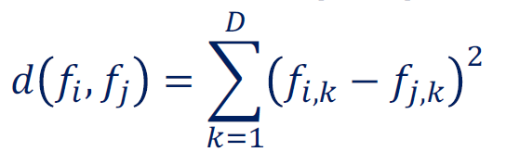
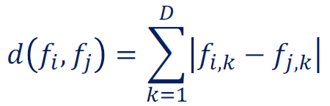
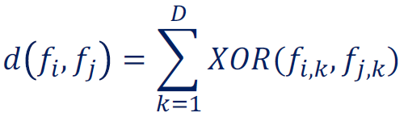
Distance Function
Sum of Squared Differences (SSD):
penalize variations between two descriptors quadratically, making it sensitive to large variations in the descriptor, but insensitive to smaller ones.
Other distance functions:
o Sum of absolute differences (SAD):
o Hamming Distance:
penalize all variations equally.
used for binary features（例えばORB）, for which all descriptor elements are binary values.

Slide 26
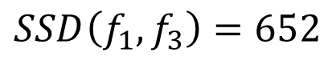
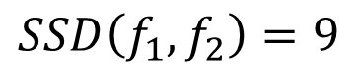
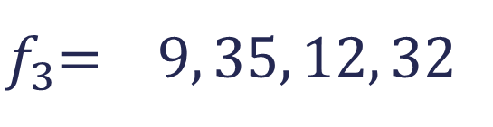


Brute Force Feature Matching
$f_{1}$= 10, 34, 23, 55
$f_{2}$= 10, 37, 23, 55
$$SSD\left(f_{1},f_{2}\right)=9$$
$$SSD\left(f_{1},f_{3}\right)=652$$
$f_{3}$= 9, 35, 12, 32
7

Slide 27





Brute Force Feature Matching
$f_{1}$= 10, 34, 23, 55
$f_{2}$= 10, 13, 23, 55
$$δ=20$$
$$SSD\left(f_{1},f_{2}\right)=441$$
$$SSD\left(f_{1},f_{3}\right)=652$$
$f_{3}$= 9, 35, 12, 32
失敗の場合：our feature detector tries to match a feature from Image 1, for which there is no corresponding feature in Image 2.
we can solve this problem by setting a distance threshold $δ$ on the acceptance of matches.
we usually define $δ$ empirically, as it depends on the application at hand and the descriptor we are using.
8

Slide 28

Brute Force Feature Matching
Define a distance function $d(f_{i},f_{j})$
the two descriptors
Define distance threshold $δ$
For every feature $f_{i}$ in Image 1:
Compute $d(f_{i},f_{j})$ with all features $f_{j}$ in image 2
Find the closest match $f_{c}$ the match that has the minimum distance
that compares
o Keep this match only if $d(f_{i},f_{j})$ is bellow threshold $δ$

Slide 29
Feature Matching
Brute force feature matching might not be fast enough for extremely large amounts of features
Use a multidimensional search tree（探索木）, usually a k-d tree to speed the search by constraining it spatially（空間的に）
Both of these matchers are implemented in OpenCV as:
o cv2.BFMatcher(): Brute force matcher
o cv2.FlannBasedMatcher(): K-D tree based approximate nearest neighbor matcher
o Link : https://docs.opencv.org/3.4.3/dc/dc3/tutorial_py_matcher.html
Kd-treeは大事。例えばLidar点群のclusteringにも使っていた。
KD-Treeのサンプルを入れたい。
Feature detection, description, and matching: These three steps are required to use features for various self-driving applications, such as visual odometry and object detection.

Slide 30


$k$-d tree
https://livebook.manning.com/book/algorithms-and-data-structures-in-action/chapter-9/v-13/19
Figure 9.2 Partitioning points in the 2-D Cartesian space by cycling through the directions along which we split. For the first split (left) we choose point R and draw a vertical line (parallel to y axis, x coordinate is constant) passing through it. We have such created 2 half-spaces, on the left (yellow) and right (blue) of this line, grouping points W, P, O, Q, U on one side, and S, T on the other. Point R is the pivot of this partitioning. Next, we choose point W in the yellow partition: this time, we draw a horizontal line (parallel to x axis, y coordinate is constant): it splits the yellow partition into 2 new partitions, one in the top-left area of the plane (red), containing P, O and U, and one in the bottom-left area (green), with just Q. If we further split the red area at point P, we need to use again a vertical line, as shown in the right-most part of the figure.
Figure 9.8 An example k-d tree for a 2-D dataset. On the left, the tree representation. On the right, a visualization of (a portion of) the 2-D cartesian plane, where the origin is at the center of the square.

Slide 31


$k$-d tree: insertion
Figure 9.11 Inserting a new point on a k-d tree (2-D). To the k-d tree in figure 9.10 we add a new point G: insertion, like for BSTs, consists of a (unsuccessful) search, after which we can identify the node that will be the parent of the node to add. In case the new point already exists on the tree, your conflicts resolution policy might lead you to ignore the duplicate, or handle it properly.
Figure 9.12 Another example of inserting a new point on a k-d tree (2-D). The starting point is the k-d tree resulting after the insertion in figure 9.11.

Slide 32


$k$-d tree: nearest neighbor
KNNは略
Figure 9.20 The first few steps of nearest neighbor search. The first phase of nearest neighbor search consists of a search on the tree, during which we keep track of the distance of each node (aka point) we traverse: more precisely, if we need to find N nearest neighbors for P, we need to keep track of the N smallest distances we find. In this case we are showing the query for N=1. Thus, if the search is successful, then we have for sure the nearest neighbor, at distance 0. Otherwise, when search ends, we are not yet sure we have found the actual nearest neighbor: in the example above, the point at the minimum distance we have found during traversal is D but, as you can see from the figure, we can’t be sure that another branch of the tree doesn’t have a point within the radius given by dist(D).
r=PA=5.12
Figure 9.21 The second step, after an unsuccessful search, is to backtrack to check other branches of the tree for closer points. It is possible to have such points because when we traverse the tree, we cycle through the coordinates that we compare at each level, so we don’t always go in the direction of the closest point, but we are forced to go on one side of the pivot, depending only on a single coordinate: so it is possible that the nearest neighbor is on the wrong side of the pivot with respect to our target point P. In this example, when we reached D, since it creates a vertical split, we needed to move to the left, as shown in figure 9.20: unfortunately the target point P and its nearest neighbor lie on opposite sites of the split line for D. So, once we reach the end of the path, we need to backtrack to check other branches.
r=PD=1.005
Backtracking（引き返す）
r=PF=0.6

Slide 33


$k$-d tree: nearest neighbor fast case & edge case
r=PF=0.6
Figure 9.22 We need to backtrack back towards the root. If we had to check every possible branch of the tree, however, this would be no better than scanning the whole list of points. Instead, we can use all the info we have to prune the search: in the geometric representation on the right, we show a visual hint of why it would be useless to check A’s right sub-branch. If you check back figure 9.21, you can notice that, instead, we knew that we couldn’t rule out D’s right sub-branch without traversing it.
Figure 9.23 Edge cases for nearest neighbor search, which require traversing the whole tree. (A) An example built on the k-d tree from figures 9.20-9.22: by carefully choosing the target point, we can force the algorithm to search the whole tree – as shown on the tree representation. (B) We show the spatial representation only of an edge case where all the points lie in a circle, and we choose the center of the circle as target of the search. Notice how the distance from P to a split line will always be shorter than the radius of the circle (which, in turn, is the distance to the nearest neighbor).

Slide 34
$k$-d tree: nearest neighbor search algorithm
function nearestNeighbor(node, target, (nnDist, nn)=(inf, null))
if node == null then
return (nnDist, nn)
else
dist ← distance(node.point, target)
if dist < nnDist then
(nnDist, nn) ← (dist, node.point)
if compare(target, node) < 0 then
closeBranch ← node.left
farBranch ← node.right
else
closeBranch ← node.right
farBranch ← node.left
(nnDist, nn) ← nearestNeighbor(closeBranch, target, (nnDist, nn))
if splitDistance(target, node) < nnDist then
(nnDist, nn) ← nearestNeighbor(farBranch, target, (nnDist, nn))
return (nnDist, nn)
←backtracking

Slide 35

$k$-d tree: region search (circle)
Figure 9.25 Region Search on a k-d tree: returns all the points in a k-d tree within a given hyper-sphere. This means looking for points within a given Euclidean distance from the sphere’s center. We start search from the root: it’s not within the sphere. The point is on A’s left branch, so we need to traverse it; but even if A is not within the sphere, the split line through it intersects the sphere, so there is a portion of the sphere intersecting the right branch of A as well (highlighted in the top-left figure). For the following steps, we are showing in parallel the execution on all branches at a given level, for the sake of space (this is also a good hint that this processes could be executed in parallel…).

Slide 36
$k$-d tree: region search (circle)
function pointsInSphere(node, center, radius)
if node == null then
return []
else
points ← []
dist ← distance(node.point, center)
if dist < radius then
points.insert(node.point)
if compare(target, node) < 0 then
closeBranch ← node.left
farBranch ← node.right
else
closeBranch ← node.right
farBranch ← node.left
points.insertAll(pointsInSphere(closeBranch, center, radius))
if splitDistance(target, node) < radius then
points.insertAll(pointsInSphere(farBranch, center, radius))
return points

Slide 37


$k$-d tree: region search (rectangle長方形)
function pointsInRectangle(node, rectangle)
if node == null then
return []
else
points ← []
if rectangle[i].min≤node.point[i]≤rectangle[i].max " 0≤i<k then
points.insert(node.point)
if intersectLeft(rectangle, node) then
points.insertAll(pointsInRectangle(node.left, rectangle))
if intersectRight(rectangle, node) then
points.insertAll(pointsInRectangle(node.right, rectangle))
return points
Figure 9.26 Region Search on a k-d tree: returns all the points in a k-d tree within a given hyper-rectangle. This means looking for points that, for each coordinate, satisfy two inequalities: each coordinate must be within a range; for instance, in this 2-D example, points’ x coordinates need to be between -2 and 3.5, and y coordinates between -4 and 2.

Slide 38

$k$-d tree: 3-d tree
Figure 9.7 An example of a 3-D tree (aka k-d tree with dimension 3). For the sake of clarity, regions are not highlighted, and nodes are filled with the same color of their split planes.

Slide 39

Feature Matching: Handling Ambiguity in Matching
Course 3, Module 2, Lesson 3 – Part 2

Slide 40




Brute Force Feature Matching: Case 3
$f_{1}$= 10, 34, 23, 55 $f_{2}$ = 10, 31, 23, 55
$δ$ = 20
$$SSD\left(f_{1},f_{2}\right)=9$$
$$SSD\left(f_{1},f_{3}\right)=9$$
Ambiguous matches
解決⽅法：Distance Ratio.
$f_{3}$= 7, 34, 23, 55
5

Slide 41


Distance Ratio [Lowe 1999]
SIFTの発明者
Compute $d(f_{i},f_{j})$ for each feature, $f_{i}$, with all features,
$f_{j}$, in image 2
Find the closest match $f_{c}$
Find the second closest match $f_{s}$
Find how better the closest match is than the second closest match. This can be done through distance ratio:
ここはNNじゃなく、KNNが必要（k=2）
If the distance ratio is close to 1, it means that according to our descriptor and distance function, matches both and .
In this case, we don’t want to use this match in the processing later on, as it clearly is not known to our matcher which location in Image 2 corresponds to the feature in Image 1.

Slide 42



Brute Force Feature Matching: Updated
Define a distance function $d(f_{i},f_{j})$
the two descriptors
Define distance ratio threshold $ρ$
For every feature $f_{i}$ in Image 1:
Compute $d(f_{i},f_{j})$ with all features $f_{j}$ in image 2
Find the closest match $f_{c}$ and the second closest match $f_{s}$
that compares
somewhere around 0.5.
distanceのthresholdがなくていいの？
3. Compute the distance ratio
4. Keep matches with distance ratio < $ρ$.

Slide 43



Brute Force Feature Matching: Case 3
$f_{1}$= 10, 34, 23, 55 $ρ$ = 0.5 $f_{2}$= 10, 31, 23, 55
$$SSD\left(f_{1},f_{2}\right)=9$$
$$SSD\left(f_{1},f_{3}\right)=9$$
$f_{3}$= 7, 34, 23, 55
8

Slide 44
Summary
Ambiguous matches are features in the first image that have a similar distance to two or more features in the second image.
Ambiguous matches can be handled by computing a distance ratio, and making sure this ratio is lower than a predefined threshold for all of our matches.
Next: Outlier Rejection
Unfortunately, even with the distance ratio formulation, as much as 50% of typical matches can still be wrong when using modern descriptors.
This is because repetitive patterns in images and small variations in pixel values, are often sufficient to confuse the matching process.
Outliers.

Slide 45
Outlier Rejection
Course 3, Module 2, Lesson 4
Feature matchers are not very robust to outliers.

Slide 46






Image Features: Localization
Problem: Find translation $T=[t_{u},t_{v}]$ in image coordinate system between image 1 and image 2.
Translationだけの例
$$t_{u}$$
$$t_{v}$$
Images from CITYSCAPES dataset: https://www.cityscapes- dataset.com/
In practice, we’d also want to solve for the scale and skew due to different viewpoints.

Slide 47
Image Features: Localization

Slide 48


Image Features: Localization
Matched feature pairs in images 1 and 2:
Model:

Slide 49


Image Features: Localization
Problem: Find translation $T=[t_{u},t_{v}]$ in image coordinate system between image 1 and image 2
Solve using least squares:
Outliers can comprise a large portion of our feature set, and typically have an out-sized negative effect on our model solution, especially when using least squares estimation.
だからidentify these outliers and avoid using them in least squares solution.
最小2乗は多い（もしくは大きい）外れ値に弱い

Slide 50

Outliers
We use a tolerance to determine the inliers, since it is highly unlikely that we satisfy the model with a 100% precision.
Outlier

Slide 51



Random Sample Consensus (RANSAC)
Fischler & Bolles 1981.
RANSAC Algorithm:
Initialization:
Given a Model, find the smallest number of samples, $M$, from which the model can be computed
Main Loop:
From your data, randomly select $M$ samples
Compute model parameters using the selected $M$ samples
Check how many samples from the rest of your data actually fits the model. We call this number the number of inliers $C$
If $C$ > inlier ratio threshold or maximum iterations reached, terminate and return the best inlier set. Else, go back to step 2
Final Step:
Recompute model parameters from entire best inlier set
平面を予測するなら、$M=3$.
$M=1$ pair of feature matches.
one pair of featureで既に$t_{u},t_{v}$を計算できるから。
許容「きょよう」距離というパラメータが必要

Slide 52
RansaC: Iteration 1

Slide 53





RansaC: Iteration 1
$$t_{u}$$
$$t_{v}$$

Slide 54

RansaC: Iteration 1
$$C=0$$

Slide 55
RansaC: Iteration 2

Slide 56




RANSAC: Iteration 2
$$t_{u}$$
$$t_{v}$$

Slide 57


RANSAC: Iteration 2
$$C=11$$

Slide 58
Summary
カメラprojectにcv::findHomographyを使って、外れたマッチングを消してみた。Homographyは２つフレームの変換モデル。findHomographyはRANSAN方法を利用して、最適Homographyを計算する。また、外れ値もマークされる。
Outliers are wrong feature matching outputs, that can occur due to errors in any of the three stages of feature usage
RANSAC can be used to efficiently arrive to a good model even when outliers are among the matched features
Next: Visual Odometry
Outlier removal is a key process in improving robustness when using feature matching, and greatly improves the quality of localization results.

Slide 59
Visual Odometry
Course 3, Module 2, Lesson 5
正にORB_SLAM2がやっていることだと思う。

Slide 60
Visual Odometry
Incrementallyという言葉が出たら、大体drift課題があると思う。
similar to the concept of wheel odometry, but with cameras instead of encoders.
Visual Odometry (VO): is the process of incrementally（徐々に） estimating the pose of the vehicle by examining the changes that motion induces on the images of its onboard cameras
VO Pros:
Not affected by wheel slip in uneven terrain, rainy/snowy weather, or other adverse conditions.
More accurate trajectory estimates compared to wheel odometry.
VO Cons:
Usually need an external sensor to estimate absolute scale
Camera is a passive sensor, might not be very robust against weather conditions and illumination changes
Any form of odometry (incremental（漸増「ぜんぞう」） state estimation) drifts over time, as seen in Course 2
we usually cannot estimate the absolute scale from a single camera.
often a second camera or an inertial measurement unit.
What this means is that estimation of motion produced from one camera can be stretched or compressed in the 3D world without affecting the pixel feature locations by adjusting the relative motion estimate between the two images.
For this reason, we often quote VO performance as a percentage error per unit distance travelled.
difficult to perform VO at night and in the presence of headlights（前照灯「ぜんしょうとう」） and streetlights（街灯）.

Slide 61




Problem Formulation:
Estimate the camera motion $T_{k}$ between consecutive images $I_{k−1}$ and $I_{k}$
Concatenating these single movements allows the recovery of the full trajectory of the camera, given frames $C_{1},……,C_{m}$
Since the camera is rigidly attached to the autonomous vehicle, this also represents an estimate of the vehicle’s trajectory.

Slide 62




Visual Odometry:
Given: two consecutive image frames $I_{k−1}$ and $I_{k}$
Extract and match features $f_{k−1}$ and $f_{k}$ between two frames $I_{k−1}$ and $I_{k}$
Estimate motion between frames to get $T_{k}$
Local optimization within multiple frame pairs (optional)
Feature Detection
Feature Description
Feature Matching
Motion Estimation
Local Optimization

Slide 63


Motion Estimation
Correspondence types:
2D-2D: both $f_{k−1}$ and $f_{k}$ are defined in Image coordinates
This form of visual odometry is great for tracking objects in the image frame.
This is extremely useful for visual tracking and image stabilization（手ぶれ補正機構） in videography.
3D-3D: both $f_{k−1}$ and $f_{k}$ are specified in 3D
requires the ability to locate new image features in 3D space, and is therefore used with depth cameras, stereo cameras（ステレオカメラ）, and other multi-camera configurations that can provide depth information.
3D-2D: $f_{k−1}$ is specified in 3D and $f_{k}$ are their corresponding projection on 2D
Feature Detection
Feature Description
Feature Matching
2D-2D
3D-3D
Motion Estimation
3D-2D
3D-2D

Slide 64























3D – 2D motion estimation
Given:
3D world coordinates of features in frame k-1
2D image coordinates in frame k
Camera Projection:
$K$ is known from calibration
C k -1
Estimate $[R|t]$
[$R|t$]
C _{k}
Note that since we cannot recover the scale for a monocular visual odometry directly, we include a scaling parameter when forming the homogeneous feature vector from the image coordinates.

Slide 65



Perspective N Point (PNP)
Camera Projection:
Direct linear transformation（直接線形変換）: (https://en.wikipedia.org/wiki/Direct_linear_transformation) an algorithm which solves a set of variables from a set of similarity relations: $x_{k}$ ∝ $Ay_{k}$ , for $k=1,…,N$. Where $x_{k}$ and $y_{k}$ are known vectors, ∝ denotes equality up to an unknown scalar multiplication, and $A$ is a matrix (or linear transformation) which contains the unknowns to be solved.
PnP:
Solve for initial guess of $[R|t]$ using Direct Linear Transform (DLT)
Forms a linear model and solves for $[R|t]$ , with methods such as singular value decomposition (SVD)
Improve solution using Levenberg-Marquardt algorithm (LM)
Need at least 3 points to solve (P3P), 4 if we don’t want ambiguous solutions. However, the more features we have, the better!
Use RANSAC if needed to handle outliers
However, the equations we have are nonlinear in the parameters of and .
iterative nonlinear optimization technique
when only 3 features, 4 possible solutions results.
RANSAC can be incorporate into PnP by assuming that the transformation generated by PnP on four points is our model. We then choose a subset of all feature matches to evaluate this model and check the percentage of inliers that result to confirm the validity of the point matches selected

Slide 66
Perspective N Point (PNP)
OpenCV has an implementation of the PnP algorithm !
cv2.solvePnP(): Solves for camera position given 3D points in frame k-1, their projection in frame k, and the camera intrinsic calibration matrix
cv2.solvePnPRansac(): Same as above, but uses RANSAC to handle outliers

